Slide 1
Silhouette Analysis of Humans in Videos
Supervisor
Dr. P. Nagabhushan
Prof & Head Dept of CSE, University of Mysore
Vejey Subash .G
M.Tech Computer Vision & Image Processing

Slide 2
Agenda
The Problem …
Why this Problem significant ?
How this Problem is tackled
Solutions approach
Questions

Slide 3
The Problem …
Tracking, identifying & recognising the movements of humans from the videos available by extracting silhouettes
“How many people are there in the scene?”
“What is the identity of each person?”
“Were this person been here before?”
“If so when is the last time he was here?”
“ With whom has he interacted?“

Slide 4
Why this problem significant ?
Crimes have increased in almost every place like shopping malls, banks, markets, parking lots, homes, everywhere
Great loss of life or asset can be saved if suspicious activity is detected beforehand
Human behavior analysis can be wonderful groundwork for various systems

Slide 5
System Design
Motion detection module
Identity tracker module
Activity Recogniser module
Integrator

Slide 6
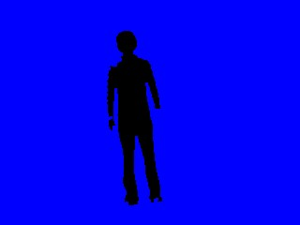
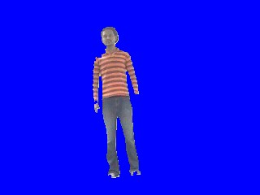
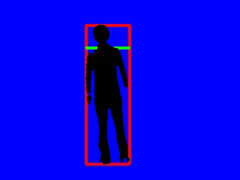
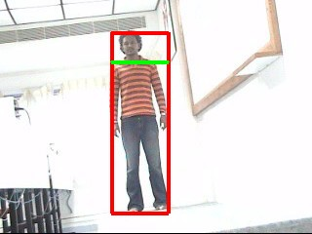
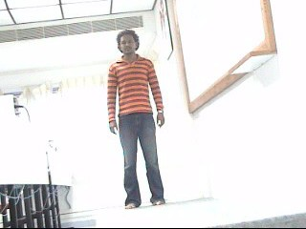
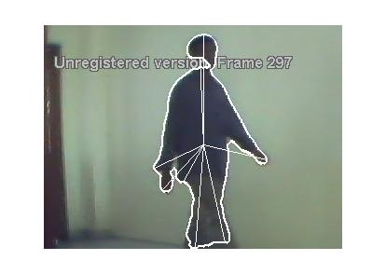
Architecture of the tracking system
Identity Tracker
Video Image
Motion Detector
Integrator
Activity Recogniser

Slide 7
Motion Detector

Slide 8
Motion detector
Video Image
Background Image
Thresholding
Motion Image
Filtering
Cleaning of blobs
Non-noisy image
Dilation / Erosion
Blob
Bounding Box
Bound Blobs
Proximity analysis
Region
Head Detector
Head region

Slide 9
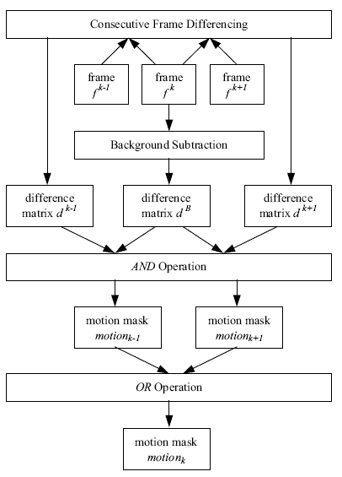
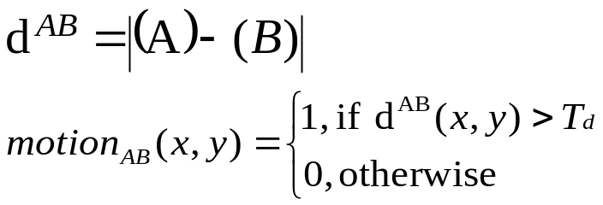
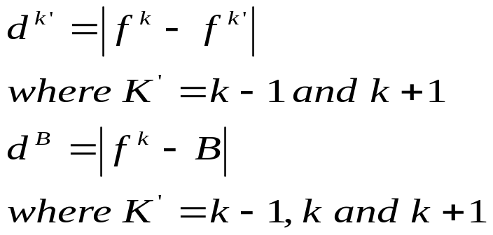
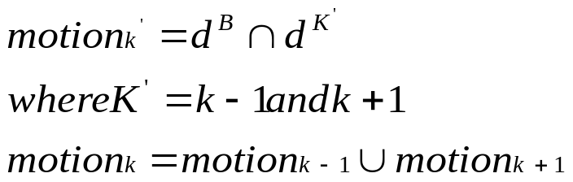
Combined BS-TD method
Difference Image

Slide 10
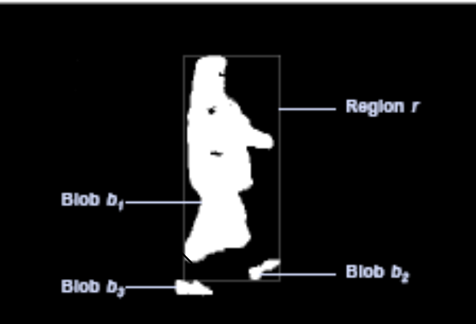
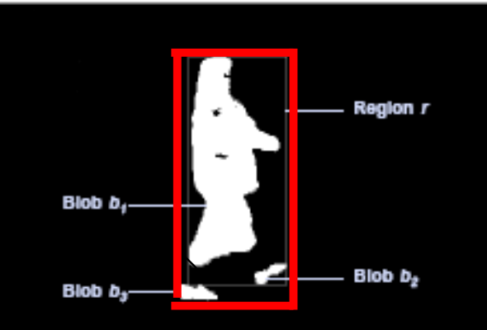
Proximity recovery of blobs
Draw the bounding box of the blobs and store the sizes of each box.
Check whether any box of size so small than the present box size exists in a span of 100 pixels across the border of the box.
If it exists, add the small blob to the current blob and redraw the bounding box with the small blob included.
Human object with three blobs separated
Three blobs joined to form a region formed of one or more blobs

Slide 11
Head Detector
Input: Blobs with bounding box
Output: Box-bound blobs with head detected
Find the length of the bounding box and mark the half of it giving the torso, head in first half and the thigh, leg in other half.
Mark one-third of the first half to get the approximate head position.

Slide 12
Issues encountered
Issues
Tentative solutions
Illumination changes, Flag & trees’ waving in wind
Person wearing the same colour of clothing as that of background
Parts of the body separated due to dilation & erosion operations
Two persons occluding each other
An adaptive background subtraction is tried out
Yet a good solution has to be provided
Proximity recovery is tried out to address this issue
Pixel classifier based on histogram color distance is proposed and has to be implemented

Slide 13
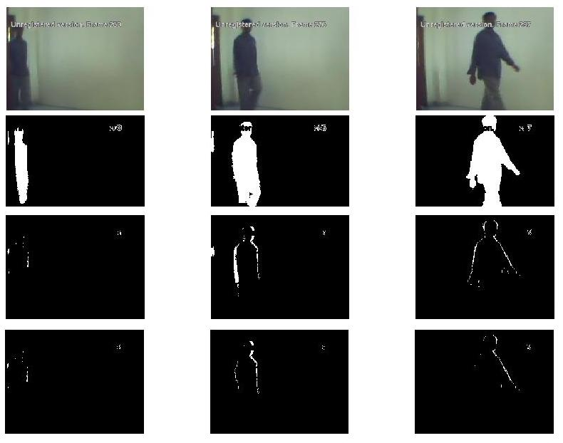
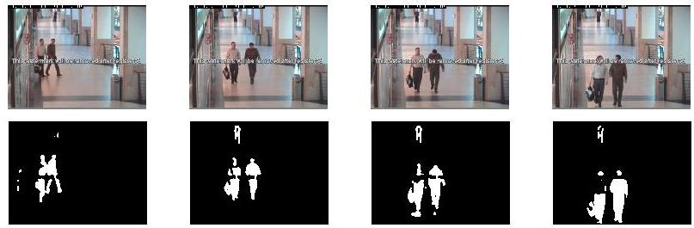
Results of Background subtraction methods

Slide 14
Identity Tracker

Slide 15
Identity tracker
Input: Blobs with bounding box from motion detector
Output: Tracked blobs with its trajectory
Compute histogram of the blob.
Correlate with the histograms of all the models available.
Find the maximum value of the correlation results.
If maximum value is less than a threshold
  Add a new model with the histogram of blob to the available list.
  Else
  Mark the blob as belonging to the corresponding model having maximum correlation value.
Compute the centroid of the blob and keep track of the blobs’ trajectory.
Get the blobs of the next frame from motion detector.

Slide 16
Histogram model
Histogram_{index} = ( red / 32 ) + 8 * ( green / 32 ) + 64 * ( blue / 32 )
Parameters
Bins
distance measures
Greater the bin size, greater the accuracy and higher the computation

Slide 17
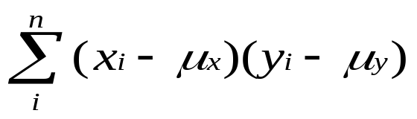
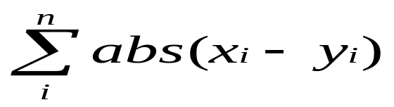
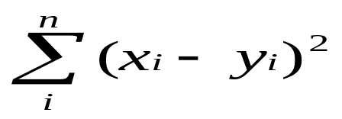
Distance measures & model updation
Distance Measures
Model Updation equation

Slide 18
Boundary checker
For every blob,
If it touches the boundary
discard the blob.
Else
process the blob further.

Slide 19
Boundary Box collision detector
If the bounding boxes of any two blobs collide
  switch to pixel classifier mode
  Else
  Carry on with the identity tracker module

Slide 20
Pixel Classifier
Occluded Blob
1-distance
2-distance
8-distance

Slide 21
Pixel classifier contd…
For each pixel in the occluded blob,
  8-distance histogram is computed
  Correlate it with the models available
  Find the best match and assign the colour of the model
Assign the whole blob to the maximum occurring model colour.
No model updation is done during the pixel classifier mode.

Slide 22
Issues encountered
Issues
Tentative solutions
Fixing of thresholds
Person wearing the same colour of clothing as that of background
Entry and exit of persons in the scene
Two persons occluding each other
Empirical solution is provided for time-being by trial & error analysis
Yet a good solution has to be provided
Boundary checker is deployed
Pixel classifier based on histogram color distance is proposed and has to be implemented

Slide 23
Correlation results & Look-up table
Blob / Model
Subash
Vasanth
Arjun
Jayaram
Models
Colour of the model
Subash
13.25
9.69
6.2
3.38
1
Red
Vasanth
8.8
12.08
5.12
2.78
2
Black
Arjun
5.88
4.95
11.99
5.8
3
White
Jayaram
3.57
2.88
5.86
11.58
4
Green
Confusion matrix of the Correlation sum of the histograms
5
Yellow
6
Cyan
7
Magenta
Lookup table for colouring of the models

Slide 24
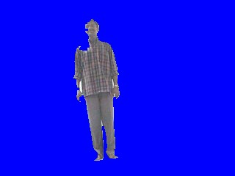
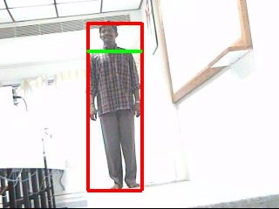
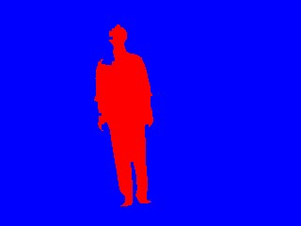
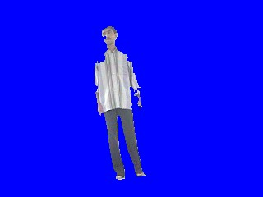
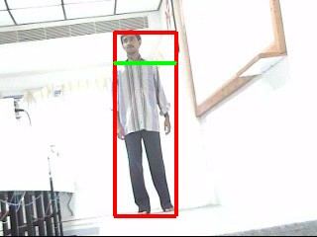
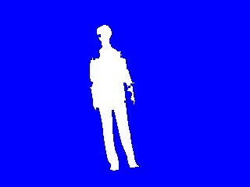
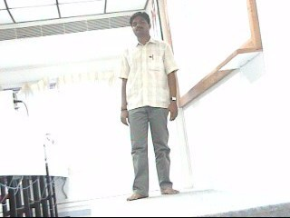
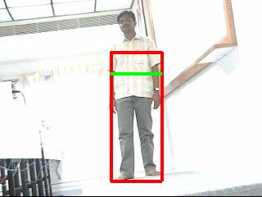
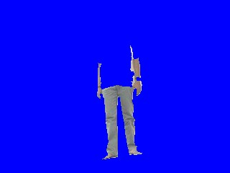
Results
Results of the identity tracker
First column -> Blob detected from motion detector module.
Second column -> Bounding Box with red rectangle and head detected with green line.
Third column -> Identity tracker results with different colours for each person.
Error in identity detection due to the effect of the background

Slide 25
Activity Recogniser

Slide 26
Activity Recogniser
Input: Tracked blobs
Output: Tracked Blobs with activities detected
Draw the contour of the blob & find boundary pixels.
Compute the centroid of the blob.
Calculate the distances of the boundary pixels from centroid.
Plot this signal as contour-distance signal with distance along y-axis and boundary pixels along x-axis.
Extract features from signal like rms, mean, median, zero crossings of the median line, number of peaks, etc.
Classify using NN for discriminating activities like walking and running.

Slide 27
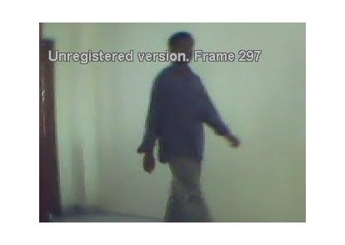
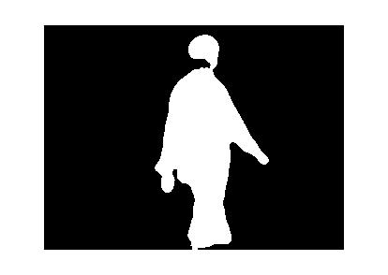
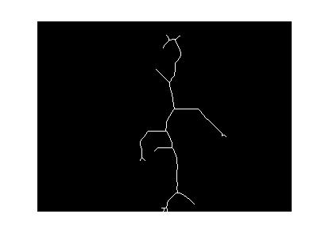
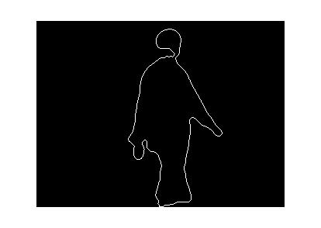
Stick model approach
Video frame
Smoothed Silhouette
Crude Skeleton
Contour

Slide 28
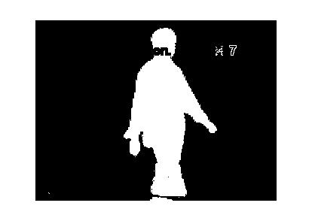
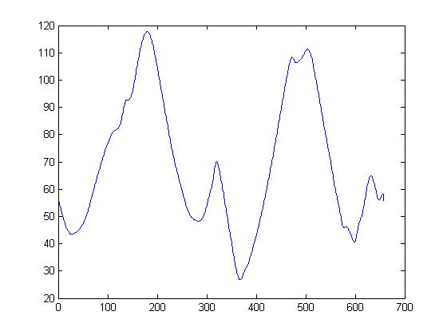
Star skeletonisation approach
Test video
Blob detected
Contour
Contour distance plot showing the distances of the boundary pixels to the centroid
Star Skeleton with the sticks

Slide 29
Issues encountered
Issues
Tentative solutions
Presence of unwanted branches in skeletonisation
Presence of spurious sticks
Entry and exit of persons in the scene
Star skeletonisation is tried out
1- D filtering to smooth spurious peaks
Boundary checker is deployed

Slide 30
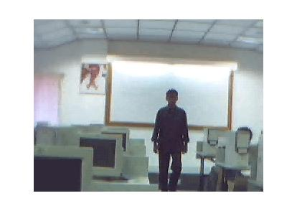
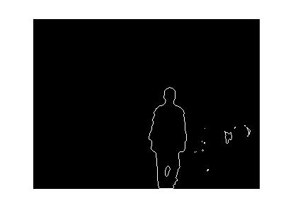
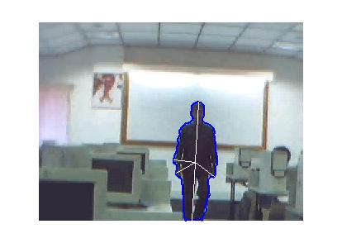
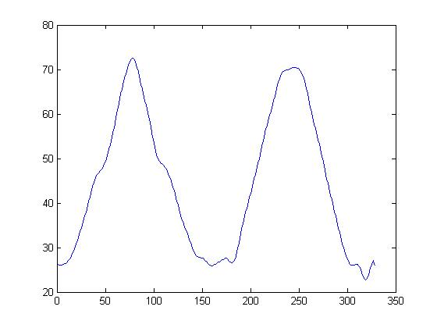
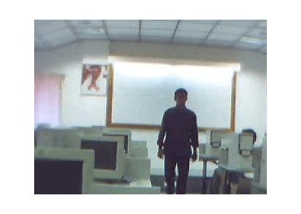
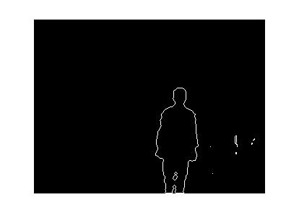
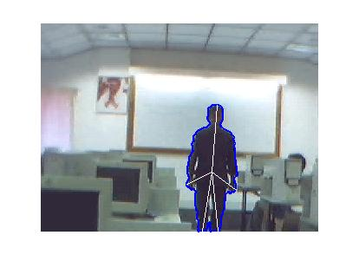
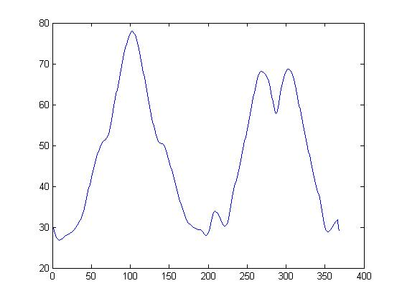
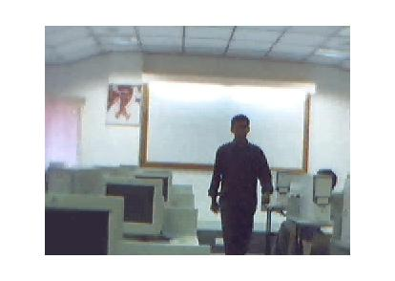
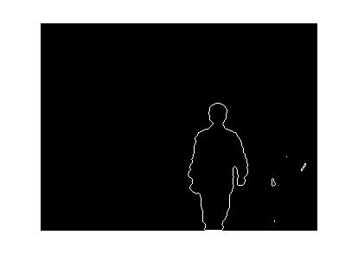
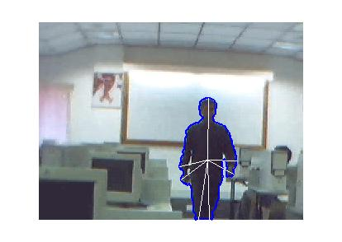
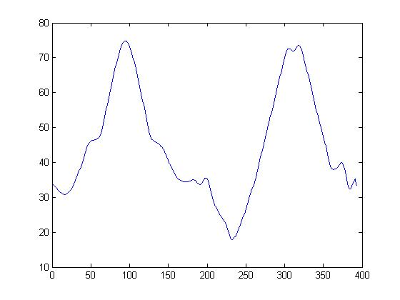
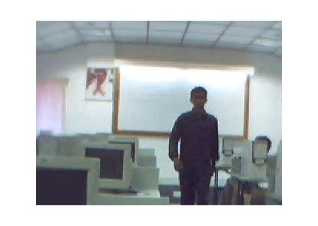
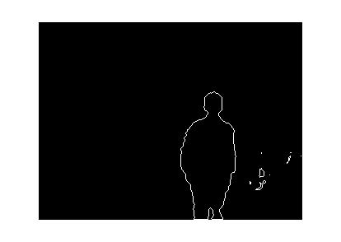
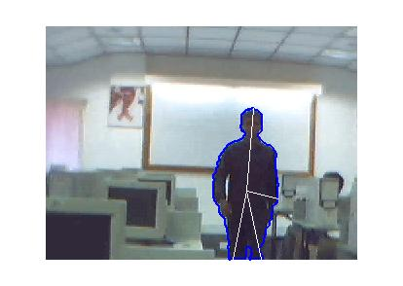
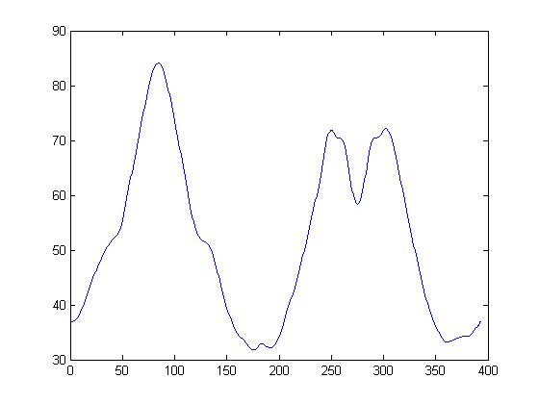
Man without an umbrella

Slide 31
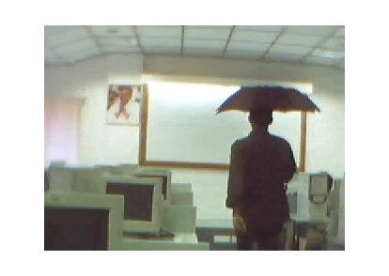
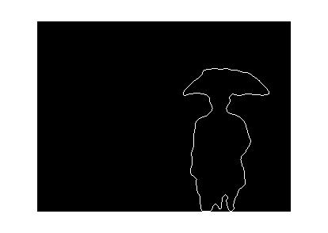














Man with an umbrella

Slide 32
Classification
From the contour-distance signal plot, features like rms, mean, median, zero crossings of the median line, number of peaks, etc. are extracted.
Neural network is used to discriminate between walking and running.
Only 47% accuracy is obtained which is considered below par.
The system runs at 12 frames per second.
Shape of the object itself can be taken as a feature for further classification.

Slide 33
Future Research
Algorithm for identifying people even in same clothing.
Algorithm for keeping track of people even in occlusion.
Keeping track of a human in heavy crowd.
Human behaviour analysis.
Vandalism prevention systems.

Slide 34
References
[1] Balcells-Capellades .M, DeMenthon .Dand Doermann .D, “An appearance based approach for consistent labeling of humans and objects in video” in Pattern Analysis and Applications, pages 1433-7541, November 2004.
[2] Chris Stauffer and Eric L Grimson, “Adaptive background mixture models for real-time tracking” in Proceedings of the IEEE Conference on Computer Vision and Pattern Recognition (CVPR’99), USA, volume 2, pages 246–252, 1999.
[3] Dariu M Gavrila and Larry S Davis, “Tracking of humans in action: A 3-D modelbased approach” in ARPA Image Understanding Workshop, Palm Springs, USA, pages 737–746, February 1996.
[4] Dariu M. Gavrila, “Vision-based 3D Tracking of Humans in Action”, Ph.D thesis, Department of Computer Science, University of Maryland, College Park, USA, 1996.
[5] Hirupouba Fujiyoshi, Alan J. Lipton & Tackco Kanade, “Real time human motion analysis by image skeletonisation ”, in IEICE Transactions & Information Systems , January 2004.
[6] Ismail Haritaoglu, David Harwood and Larry S Davis, “W4: Real-time surveillance of people and their actions” in IEEE Transactions on Pattern Analysis and Machine Intelligence, 22(8):809–830, August 2000.

Slide 35
References contd…
[7] LIU Ya, AI Haizho, XU Guangyou, “Moving Object Detection and Tracking Based on Background Subtraction”, 2001.
[8] Masanori Yamaday, Kazuyuki Ebihara, and Jun Ohya , “A New Robust Real-time Method for Extracting Human Silhouettes from Color Images” in Proceedings of the Third International Conference on Automatic Face and Gesture Recognition (FG'98), April 1998.
[9] Nicolas Chleq, Fran¸cois Br´emond and Monique Thonnat., “Image understanding for prevention of vandalism in metro stations” in Advanced Video-based Surveillance Systems, volume 488, pages 106–116, USA, November 1998.
[10] Nils T. Siebel, “Design and Implementation of People Tracking Algorithms for Visual Surveillance Applications”, Ph.D thesis, University of Reading, March 2003.
[11] Robert Fischer, “CAVIAR – Context Aware Vision using Image-based Active Recognition ”, July 11, 2004.
[12] Shabhe Mat Desa & Qussay A. Salih, “Image Subtraction in real time moving object extraction”, in Proceedings of the International Conference on Computer Graphics, Imaging and Visualization , January 2004.

